Slide 1
TITANIC SURVIVOR PREDICTOR
PRESENTED BY: MANAN CHAUHAN
GUIDED BY: SAURAV KUMAR

Slide 2
CONTENT
Introduction
Objective
Dataset Review
Technology Used
DataFlow
Methodology
Exploratory Data Analysis
Results
Conclusion

Slide 3
INTRODUCTION
The sinking of the RMS Titanic is one of the most infamous shipwrecks in history.
The Titanic billed as an unsinkable ship hit an iceberg and sank on April 15, 1912. More than 1,500 people died in the maritime disaster, while about 700 survived.
In this challenge, we ask you to complete the analysis of what sorts of people were likely to survive based on the features provided.

Slide 4
OBJECTIVE
The objective of this project was to build a classification model that could successfully determine whether a Titanic passenger lived or died based on information about multiple people like their ages, sexes, sibling counts, embarkment points.
Comparison among different Machine Learning Algorithms to identify the most accurate model for predicting the survival for a passenger

Slide 5
DATASET REVIEW
The Dataset was provided by our mentor and it consists of 891 rows and 12 columns, providing detailed information about the passenger.
The dataset consists of Numerical as well as Categorical data.
The dataset had some null values that were handled.
The primary focus of the analysis is on predicting the ‘survival of an arbitrary passenger’ based on the other features.

Slide 6
TECHNOLOGY USED
Matplotlib
Matplotlib is especially deployed for basic plotting. Bars, pies, lines, scatter plots and so on are part of visualisation using matplotlib, Matplotlih is a graphics package well integrated with NumPy and Pandas. The MATLAB plotting commands are closely mirrored by the pyplot module.
Seaborn
Seaborn provides various visualization patterns. It has easy and interesting default themes and uses fewer syntax. Statistics visualization is the speciality of seaborn and it is employed while summarizing data in visuals and additionally depict the data distribution.
Logistic Regression
Logistic regression is a supervised machine learning algorithm used for classification tasks where the goal is to predict the probability that an instance belongs to a given class or not. Logistic regression is a statistical algorithm which analyze the relationship between two data factors.
Decision Tree
Decision Trees (DTs) are a non-parametric supervised learning method used for classification and regression. The goal is to create a model that predicts the value of a target variable by learning simple decision rules inferred from the data features. A tree can be seen as a piecewise constant approximation.
Random Forest
Random forest regression model combines multiple decision trees to create a single model. Each tree in the forest builds from a different subset of the data and makes its independent prediction. The final prediction for input is based on the average or weighted average of all the individual trees' predictions.

Slide 7
DATAFLOW
A data flow diagram shows the way information flows through a process or system. It includes data inputs and outputs; data stores and the various sub processes the data moves through. DFDs are built using standardized symbols and notation to describe various entities and their relationships.
True data is noisy. Therefore, it is necessary to clean data so that the actual information from the collected data can be acquired. Different processes are carried out to obtain the actual information such as manual encoding and one hot encoding. Then feature extraction is performed to extract necessary features. User can give an input to the detection model and it will provide an output.

Slide 8
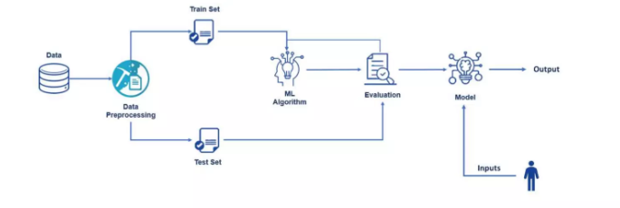
METHODOLOGY

Slide 9
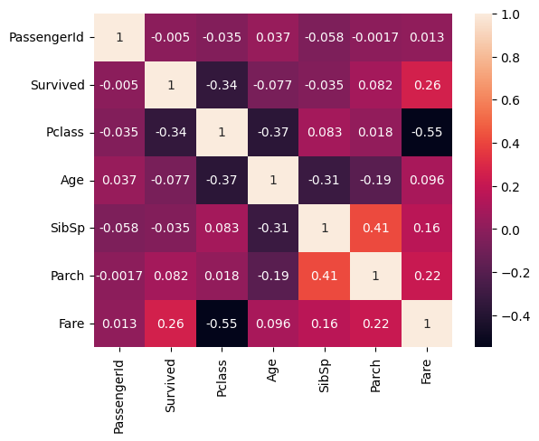
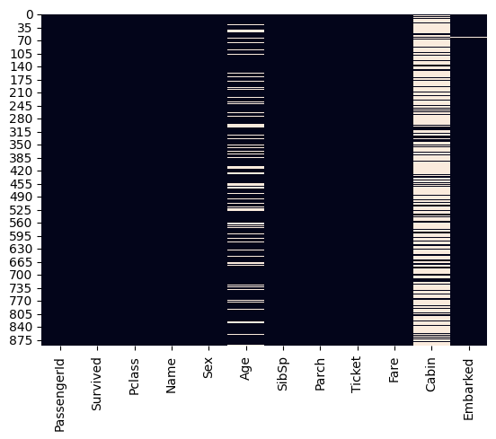
EXPLORATORY DATA ANALYSIS
Correlation between important features
Heatmap of null values in each column

Slide 10
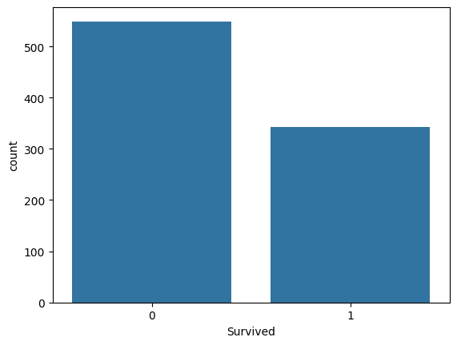
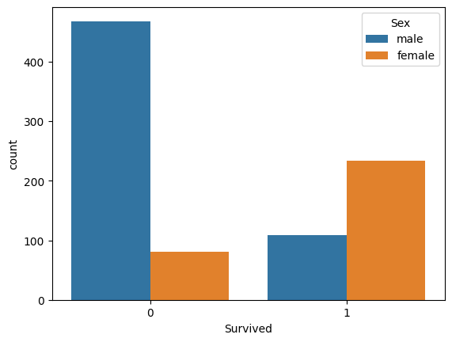
Survival Rate
Survival Graph
Survival based on Gender

Slide 11
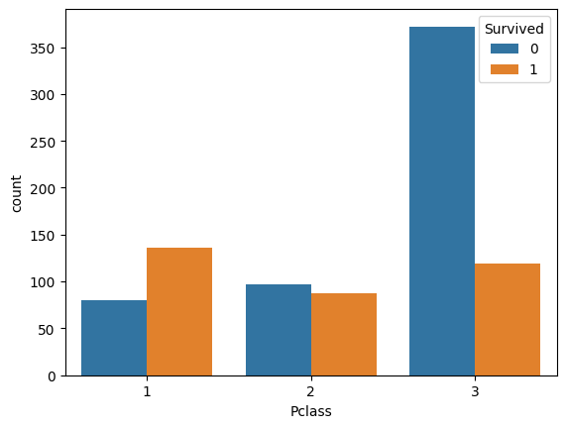
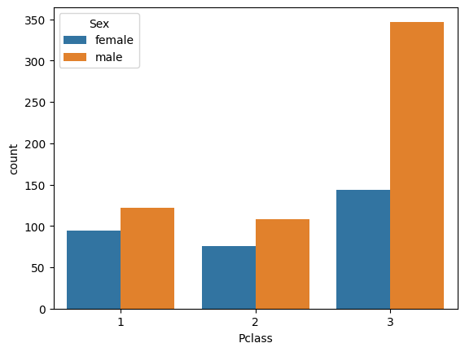
Pclass Analysis
Survival based on Pclass
Gender distibution in Pclass

Slide 12
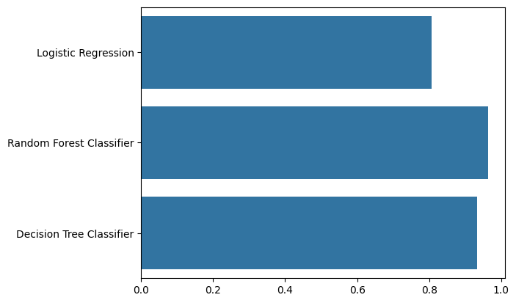
RESULTS
Classification Report for Logistic Regression Model
Classification Report for Random Forest Model
 | Precision | Recall | F1-Score | support
False | 0.60 | 0.72 | 0.66 | 85
True | 0.27 | 0.18 | 0.22 | 49
accuracy |  |  | 0.52 | 134
 | Precision | Recall | F1-Score | support
False | 0.83 | 0.91 | 0.87 | 85
True | 0.80 | 0.67 | 0.73 | 49
accuracy |  |  | 0.82 | 134
Classification Report for Decision Tree Model
Cross Validation Scores
 | Precision | Recall | F1-Score | support
False | 0.95 | 0.99 | 0.97 | 75
True | 0.98 | 0.93 | 0.96 | 49
accuracy |  |  | 0.96 | 134

Slide 13
CONCLUSION
The Cross Validation Score for Random Forest Model was the highest meaning that it’s predicitions are the most accurate among all the other Models.

Slide 14
THANK YOU

